Slide 1

Coordination Compounds
The backbone of modern inorganic and bio-inorganic chemistry.

Slide 2






Key Learning Objectives
Werner's Theory
Terminology
Appreciate the postulates of Werner's theory of coordination compounds.
Understand key terms: coordination entity, ligand, coordination number, oxidation number, etc.
Nomenclature
Isomerism
Learn rules for naming and writing formulas of coordination compounds.
Define different types of isomerism in coordination compounds.
Bonding Theories
Applications
Understand bonding via Valence Bond and Crystal Field theories.
Appreciate importance and applications in daily life.

Slide 3
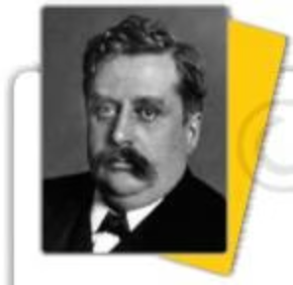
Werner's Theory of Coordination Compounds
Alfred Werner (1866-1919) formulated early ideas on coordination compound structures.
He proposed primary (ionizable) and secondary (non-ionizable) valences for metal ions.
Werner won the Nobel Prize in 1913 for his work on the linkage of atoms and coordination theory.
Secondary valence equals the coordination number, fixed for each metal.

Slide 4
Werner's Experimental Observations
Werner studied cobalt(III) chloride-ammonia compounds, observing varying AgCl precipitation with AgNO3:
Formula
Color
AgCl Precipitated (mol)
CoCl3·6NH3
Yellow
3
CoCl3·5NH3
Purple
2
CoCl3·4NH3
Green/Violet
1
These findings led to the concept of coordination entities and isomers.

Slide 5
Key Terms in Coordination Chemistry
Coordination Entity
Central Atom/Ion
Central metal atom/ion bonded to a fixed number of ions/molecules, enclosed in square brackets.
The atom/ion to which ligands are bound in a definite geometrical arrangement.
Ligands
Coordination Number
Ions or molecules bound to the central atom/ion. Can be unidentate, didentate, or polydentate.
Number of ligand donor atoms directly bonded to the metal ion.
Coordination Polyhedron
Oxidation Number
Spatial arrangement of ligand atoms around the central atom, e.g., octahedral, tetrahedral, square planar.
Charge the central atom would carry if all ligands were removed.

Slide 6
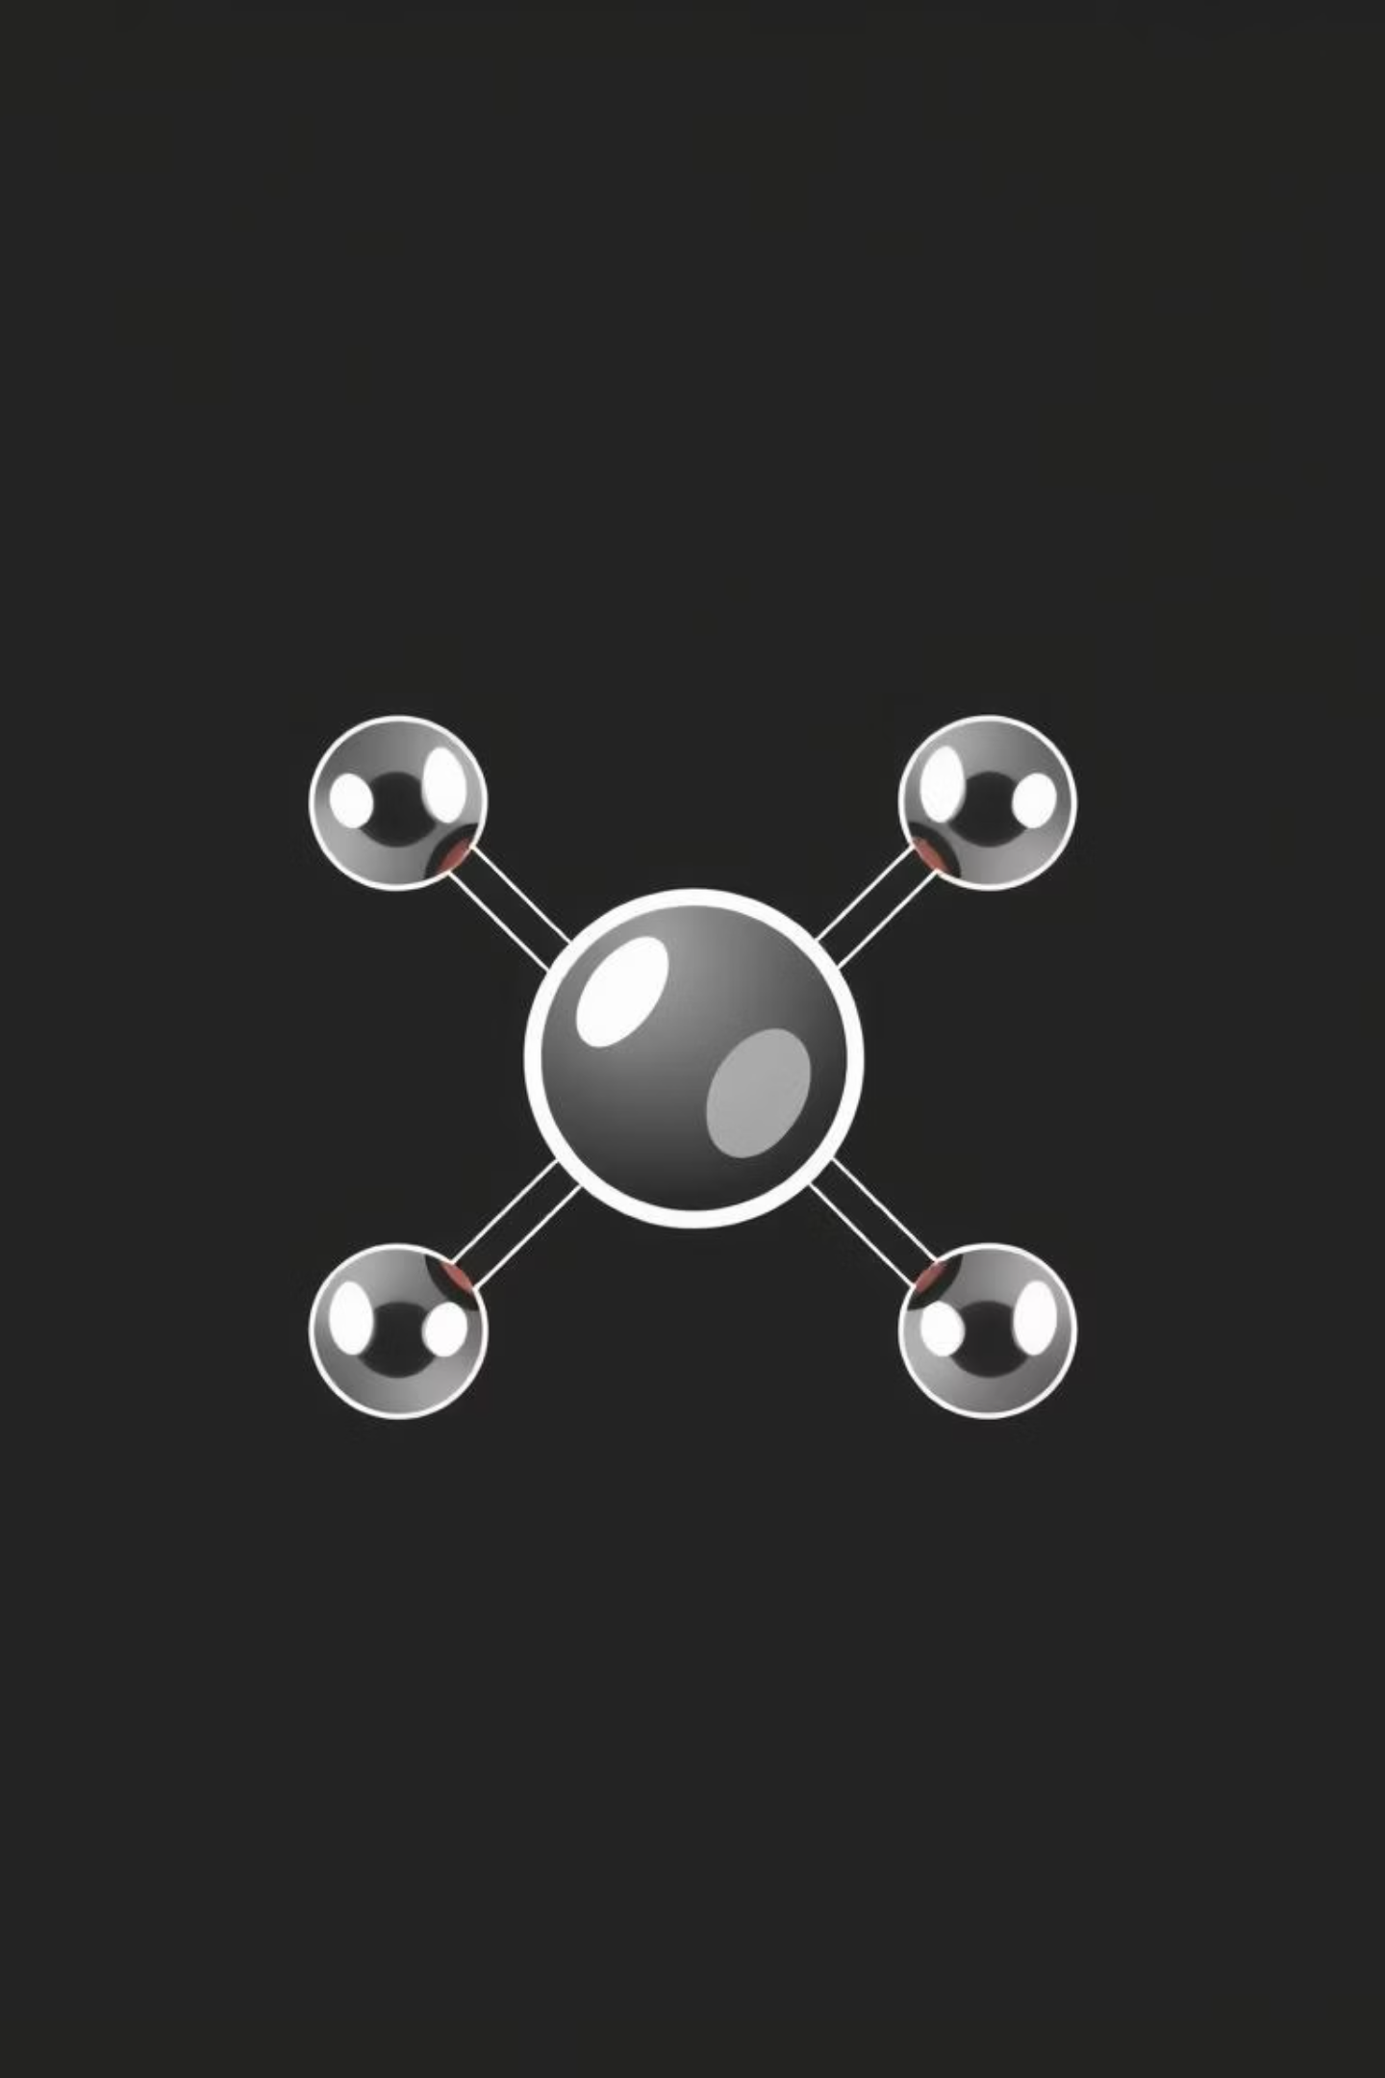
Nomenclature of Coordination Compounds
IUPAC rules ensure unambiguous naming and formula writing:
Central atom listed first, then ligands alphabetically.
Ligand names end in '-o' for anionic, others are generally unchanged (e.g., aqua, ammine).
Prefixes (di, tri, bis, tris) indicate ligand numbers.
Oxidation state of metal in Roman numerals.
Metal name changes for anionic complexes (e.g., cobaltate for cobalt).

Slide 7
Isomerism in Coordination Compounds
Isomers have the same chemical formula but different atomic arrangements, leading to distinct properties.
Stereoisomerism
Structural Isomerism
Geometrical Isomerism: Different spatial arrangements of ligands (cis/trans, fac/mer).
Linkage Isomerism: Ambidentate ligand binds through different atoms.
Optical Isomerism: Non-superimposable mirror images (enantiomers), common in octahedral complexes.
Coordination Isomerism: Ligand interchange between cationic and anionic entities.
Ionisation Isomerism: Counter ion acts as a ligand, displacing another.
Solvate Isomerism: Solvent molecule directly bonded or free in crystal lattice.

Slide 8
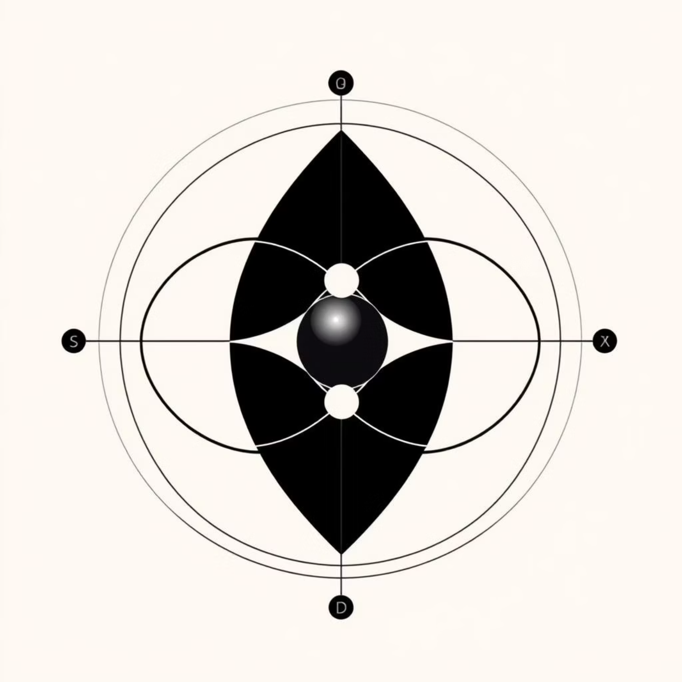

Bonding Theories: VBT and CFT
Valence Bond Theory (VBT)
Crystal Field Theory (CFT)
Metal orbitals hybridize to form equivalent orbitals for bonding with ligands.
Electrostatic model: metal-ligand bond is ionic.
Predicts geometry and magnetic behavior (diamagnetic/paramagnetic).
Ligands are point charges, causing d-orbital splitting.
Limitations: Assumptive, no quantitative magnetic data, doesn't explain color or stability.
Explains color, magnetic properties, and stability.
Limitations: Treats ligands as point charges, ignores covalent character.

Slide 9
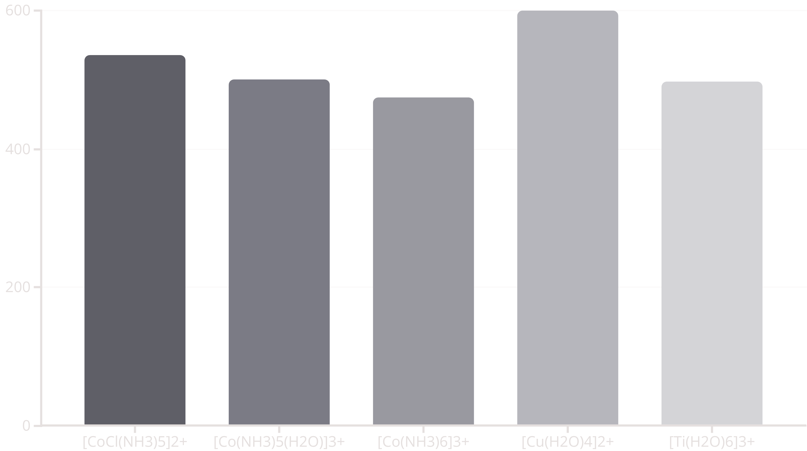
Color in Coordination Compounds
Color arises from d-d transitions when electrons absorb light and jump between split d-orbitals.
The observed color is complementary to the absorbed wavelength.

Slide 10




Importance and Applications
Analytical Chemistry
Metallurgy & Industry
Used in qualitative and quantitative analysis, e.g., EDTA for water hardness.
Essential in metal extraction (gold, silver) and purification (nickel), and as catalysts.
Biological Systems
Medicinal Chemistry
Vital components: chlorophyll (Mg), hemoglobin (Fe), vitamin B12 (Co).
Chelate therapy for metal poisoning (EDTA for lead) and anti-tumor agents (cis-platin).

